Slide 1

INTELLIGENT REMOTE HEALTHCARE AND ASSISTED LIVING ECOSYSTEM
KNOWLEDGE INSTITUTE OF TECHNOLOGY

Slide 2
INTELLIGENT REMOTE HEALTHCARE AND ASSISTED LIVING ECOSYSTEM
KNOWLEDGE INSTITUTE OF TECHNOLOGY
The Intelligent Remote Healthcare and Assisted Living Ecosystem is a smart monitoring solution designed to support elderly people, patients, and individuals who require regular assistance. The system combines health monitoring, environmental safety, emergency alerts, remote monitoring, and automatic data logging to provide continuous information about the user's condition.
An ESP32-based monitoring system collects data from multiple sensors, displays important readings on an OLED screen, and sends the information to the Blynk IoT platform for remote access and monitoring.

Slide 3
Double Content Slide
KNOWLEDGE INSTITUTE OF TECHNOLOGY
Technical Architecture Our system
The prototype uses an ESP32 microcontroller as the central processing unit. The MAX30102 monitors heart rate and SpO₂, while the MLX90614 measures body temperature. The MPU6050 identifies unusual movements and possible falls. Environmental conditions are monitored using DHT22, MQ-2, and PIR sensors. An OLED display provides local readings, while Blynk IoT enables remote monitoring..
User Value & Impact
The system provides a practical and affordable solution for continuous health and safety monitoring. It helps family members and caregivers remotely track important health and environmental conditions, receive alerts during abnormal situations, and review stored data for better observation and decision-making..

Slide 4
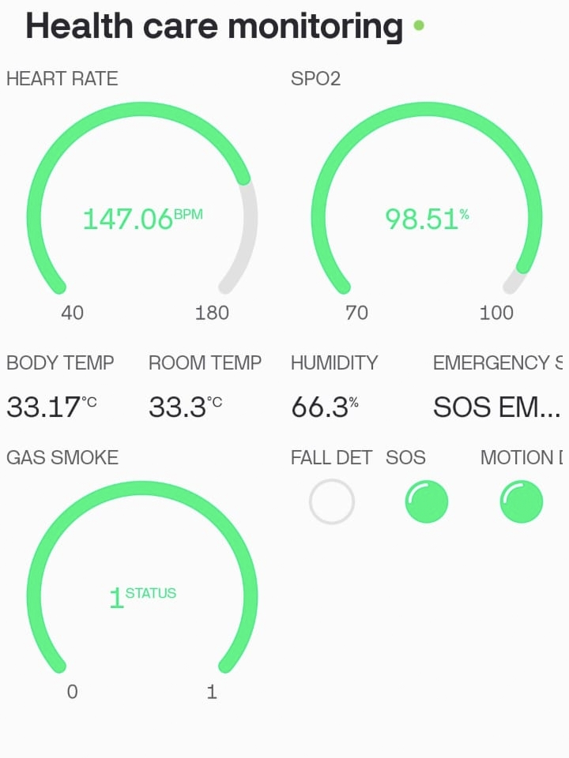
Key Features
KNOWLEDGE INSTITUTE OF TECHNOLOGY
Real-time heart rate and SpO₂ monitoring
Body temperature monitoring
Fall and unusual movement detection
Room temperature and humidity monitoring
Gas and smoke detection
Surrounding movement detection
OLED-based real-time data display
Remote monitoring through Blynk IoT
Buzzer and LED emergency alerts
Manual assistance through SOS button
Automatic sensor data logging using Python
CSV-based storage for historical analysis

Slide 5
Comparison Slide
KNOWLEDGE INSTITUTE OF TECHNOLOGY
Conventional Monitoring
Intelligent Remote Monitoring
Traditional healthcare monitoring often depends on direct supervision by family members or caregivers. Continuous observation may not always be possible, and important changes in health or environmental conditions can sometimes go unnoticed.
Unlike conventional monitoring, the proposed ecosystem continuously collects health and environmental data using multiple sensors. It provides remote access through Blynk IoT, generates alerts when abnormal conditions are detected, and stores readings automatically for later analysis.

Slide 6
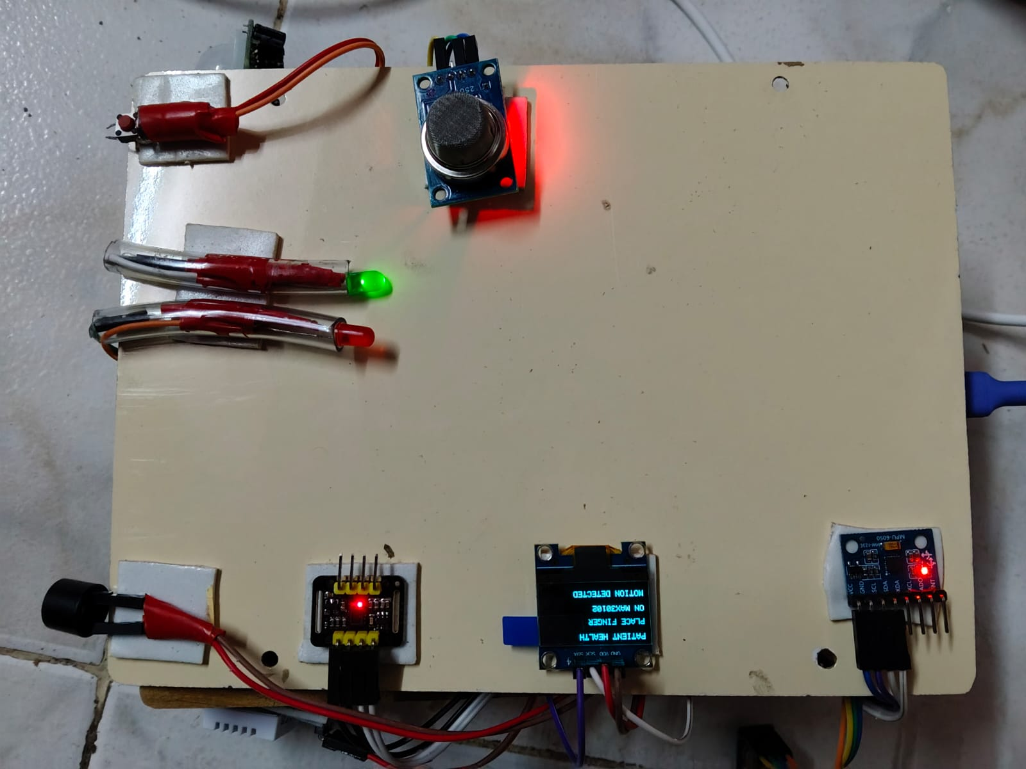
Prototype
KNOWLEDGE INSTITUTE OF TECHNOLOGY
The developed prototype integrates multiple health and environmental sensors with an ESP32 microcontroller. The MAX30102, MLX90614, and MPU6050 monitor important health-related parameters, while the DHT22, MQ-2, and PIR sensors monitor surrounding conditions.
The collected information is displayed locally through an OLED screen and transmitted to the Blynk IoT platform. A buzzer and LED indicators provide alerts, while an SOS button allows the user to manually request assistance.
.

Slide 7
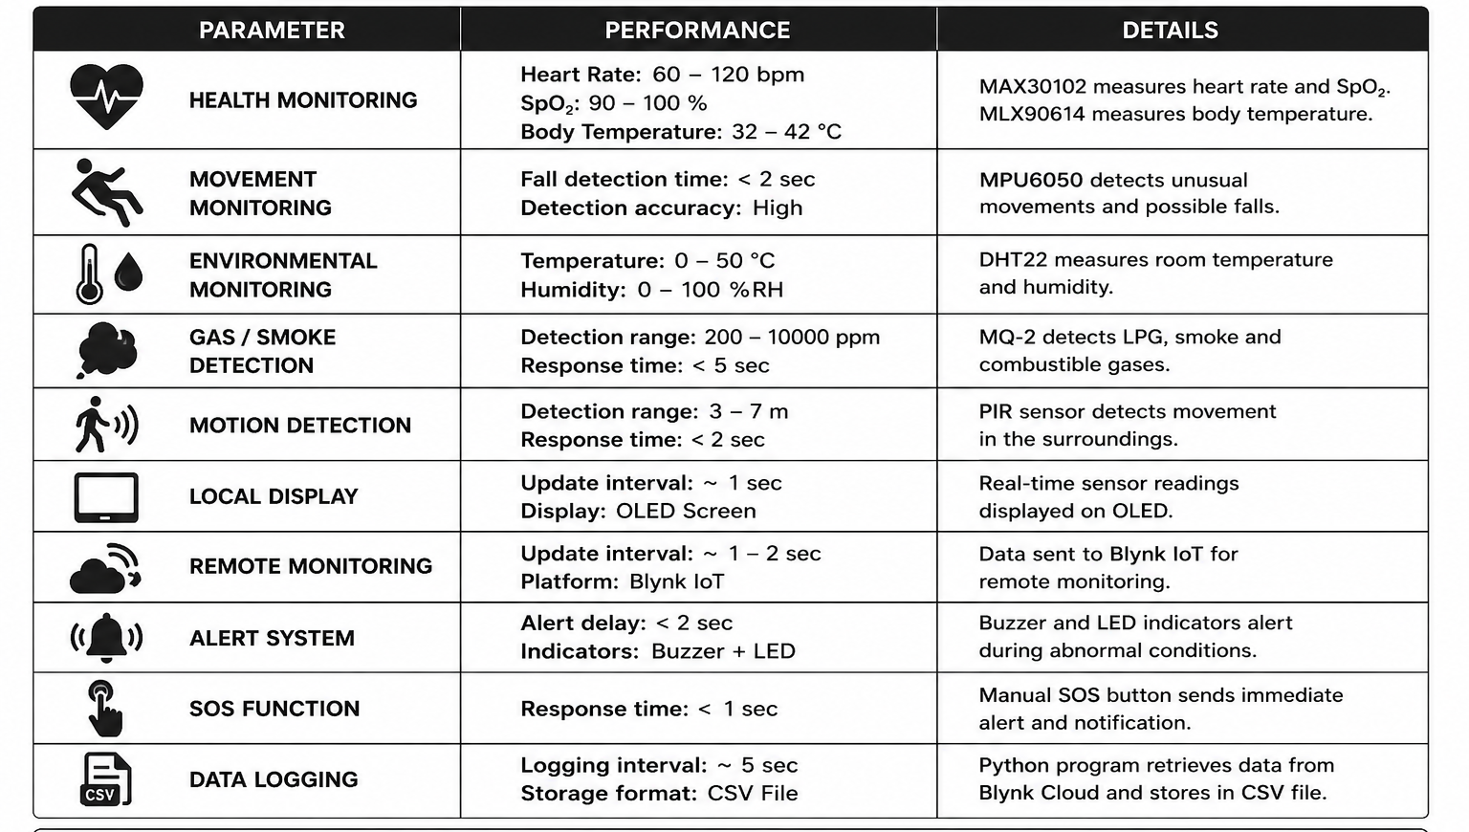
Performance breakdown
KNOWLEDGE INSTITUTE OF TECHNOLOGY
Health Monitoring: Heart rate + SpO₂ + body temperature Movement Monitoring: MPU6050-based fall detection Environmental Monitoring: Temperature + humidity + gas/smoke + motion Controller: ESP32 microcontroller Remote Monitoring: Blynk IoT platform Local Display: OLED display Emergency Alert: Buzzer + LED indicators + SOS button Data Logging: Python + CSV file Application: Remote healthcare and assisted living

Slide 8
CONCLUSION
KNOWLEDGE INSTITUTE OF TECHNOLOGY
SMART MONITORING, SAFER LIVING
The Intelligent Remote Healthcare and Assisted Living Ecosystem demonstrates how IoT technology can be used to improve health and safety monitoring for people who require regular assistance. By combining health sensors, environmental monitoring, remote connectivity, emergency alerts, and automatic data storage, the system provides a practical and affordable monitoring solution.
The proposed system can help family members and caregivers stay informed about the user's condition and respond more quickly when abnormal situations or emergencies are detected.

